Slide 1
Where Does All The Energy Go?
By Hannah Hofferberth

Slide 2
Energy Intro
Energy is crucial. It powers everything. A common type of energy is electricity. Most people use fossil fuels to create electricity. Some are trying to break away and use solar energy: using solar panels.

Slide 3
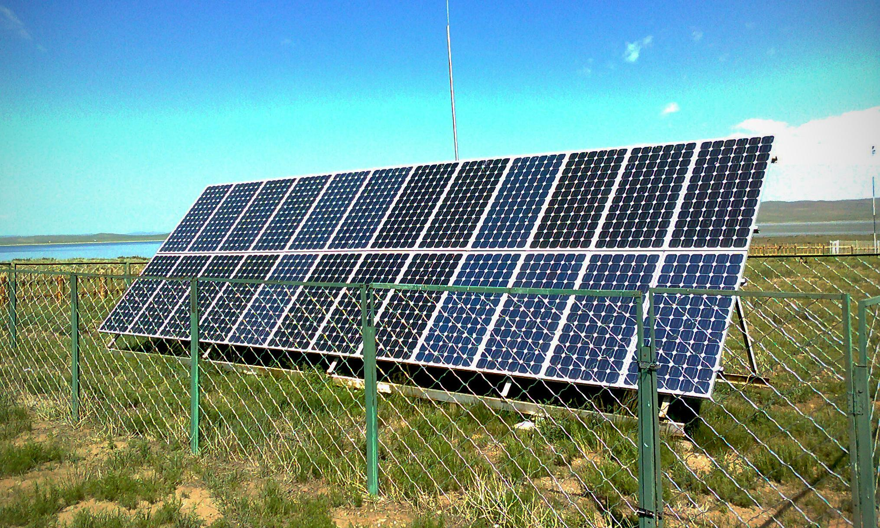
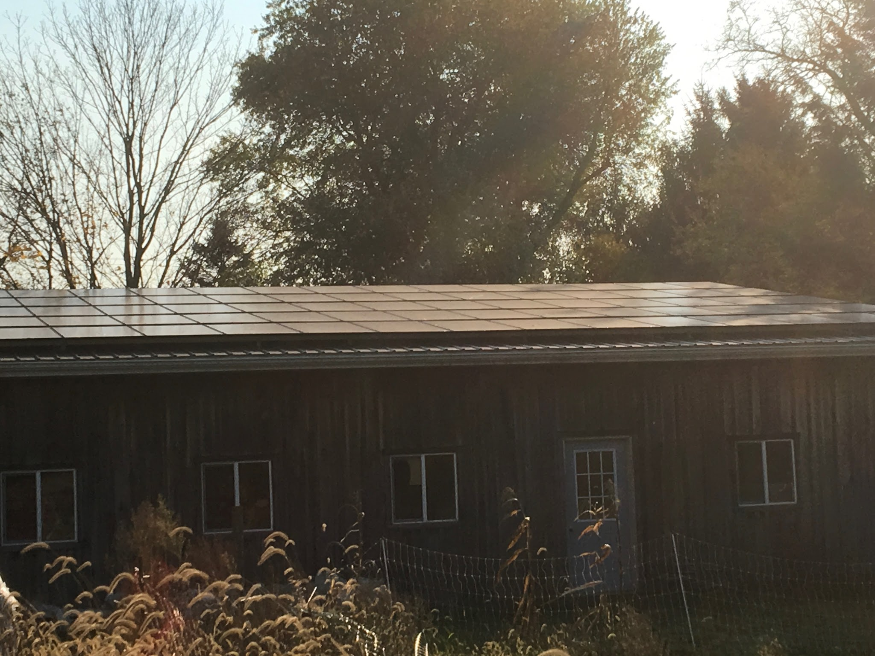
Solar Panels
Solar panels are an efficient way to save energy and help the Earth. But they won’t always work during the winter, especially when they are covered in snow. Or when shadows block out the sun. Sometimes solar users have to use regular fossil fuels.
And also, during the summer, they get a lot of energy. But where does it all go?

Slide 4
Extra Energy
I learned today that all the extra energy ends up in the electrical pipes and wires and then gets transferred into other people’s homes!
Isn’t that cool? Then the other people get a taste of solar energy. Clean and green!

Slide 5
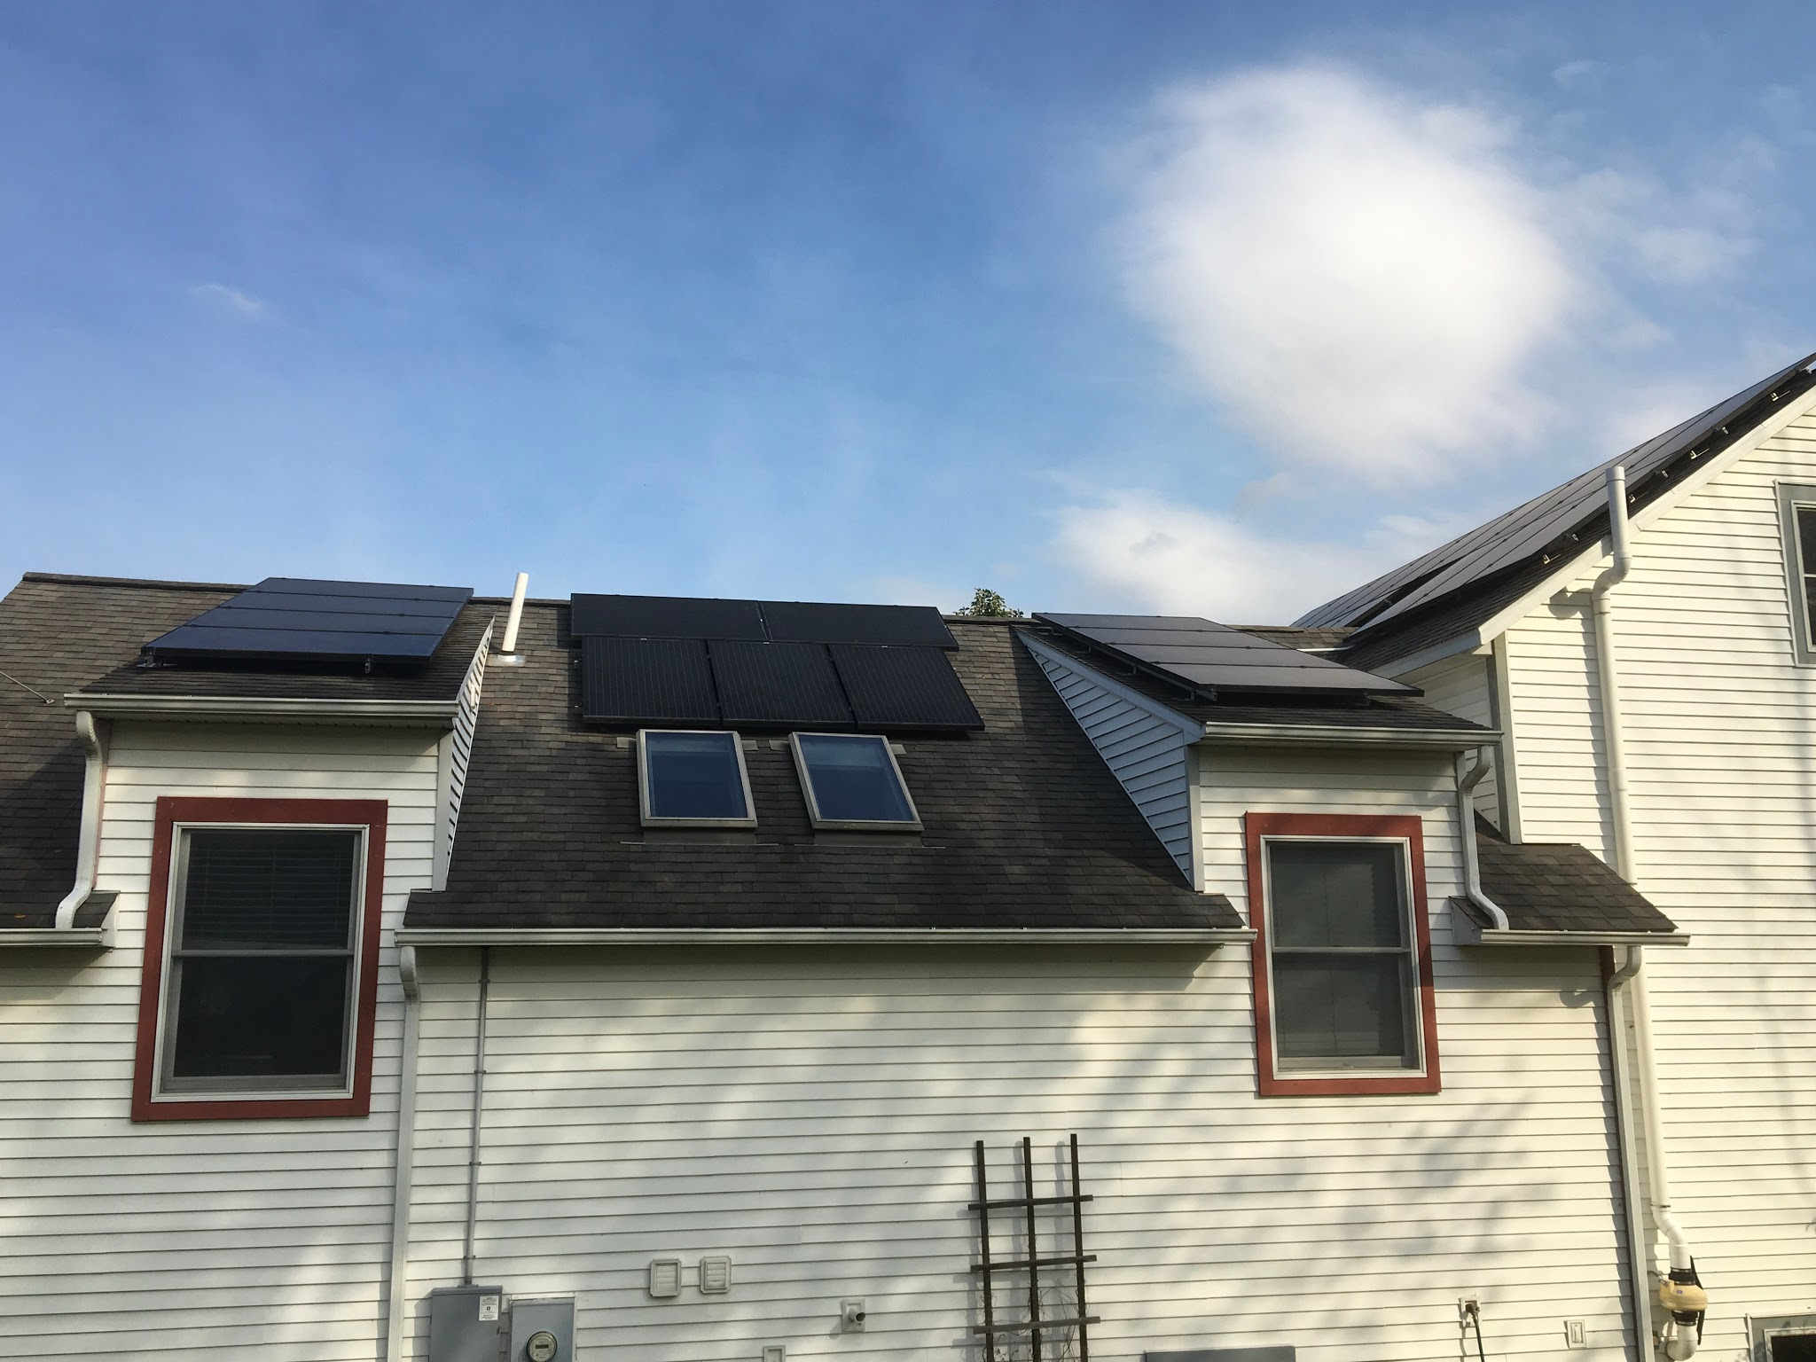
Where Might It Go?
Since the solar energy is put into the pipes and wires that anyone can use, it might go anywhere! However, it is most likely to go into nearby houses and homes.

Slide 6
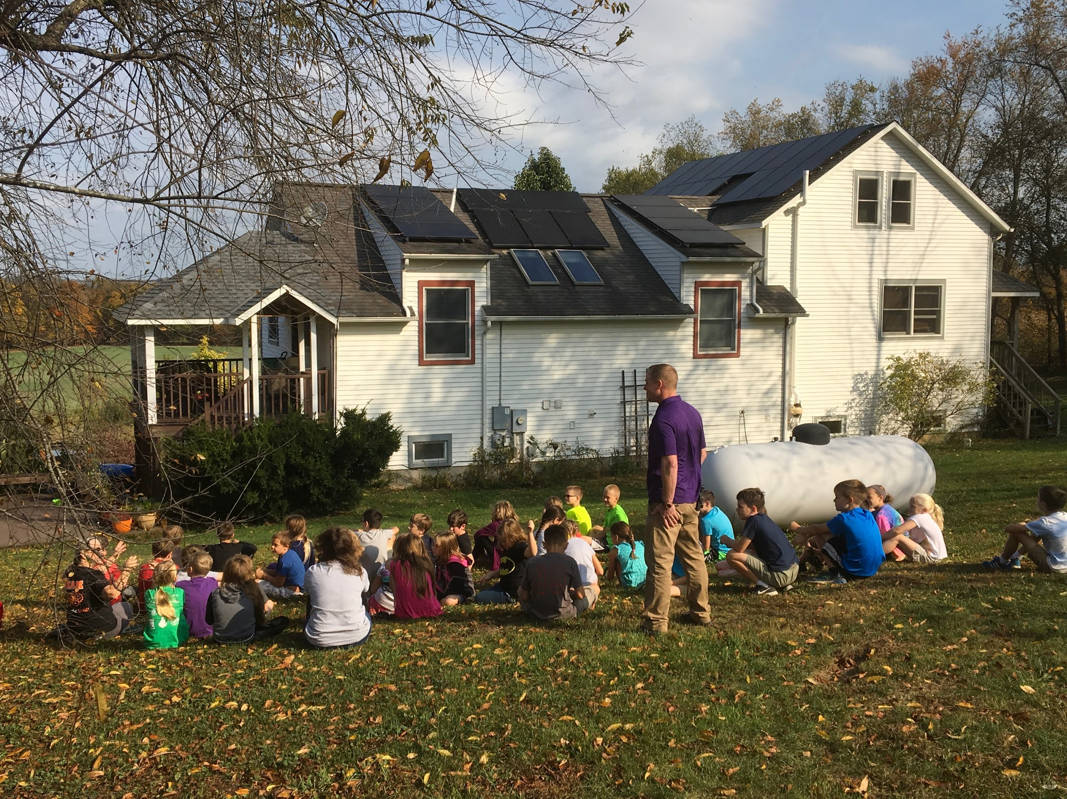
Solar Conclusion
My conclusion is: WOW! The thing I learned is something I wouldn’t have figured. I thought it would be stored somewhere until it was used. But that is good for the other houses! Solar energy is a great way to conserve, and its energy is NOT wasted!

