Slide 1
Field Trip
What I have learned. :)

Slide 2
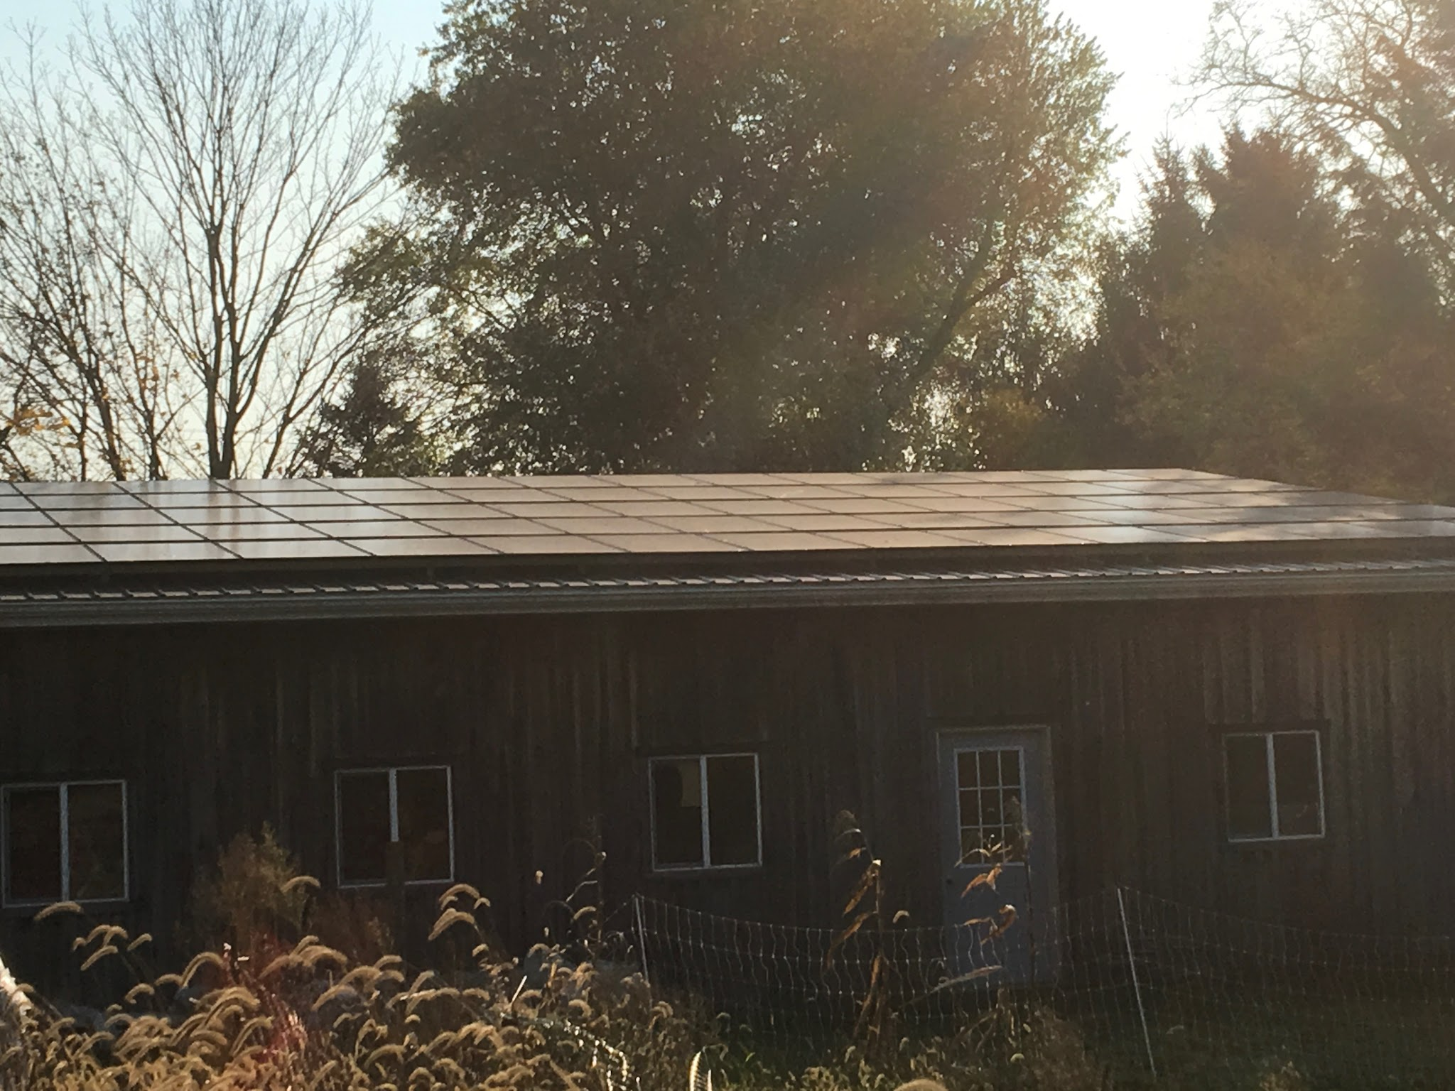
At the Kenyon Farm, I learned that the smallest little thing from a group of 5 bugs to 1 foot of snow could decrease the amount of sunlight that you receive. For instance, if it is have a cloudy day outside, you would get about 20% to 30% of the power you normally get. When it is nighttime, you don’t get any power at all. The same thing happens when 1 foot of snow falls on the panels, you don’t get any sunlight at all.

Slide 3
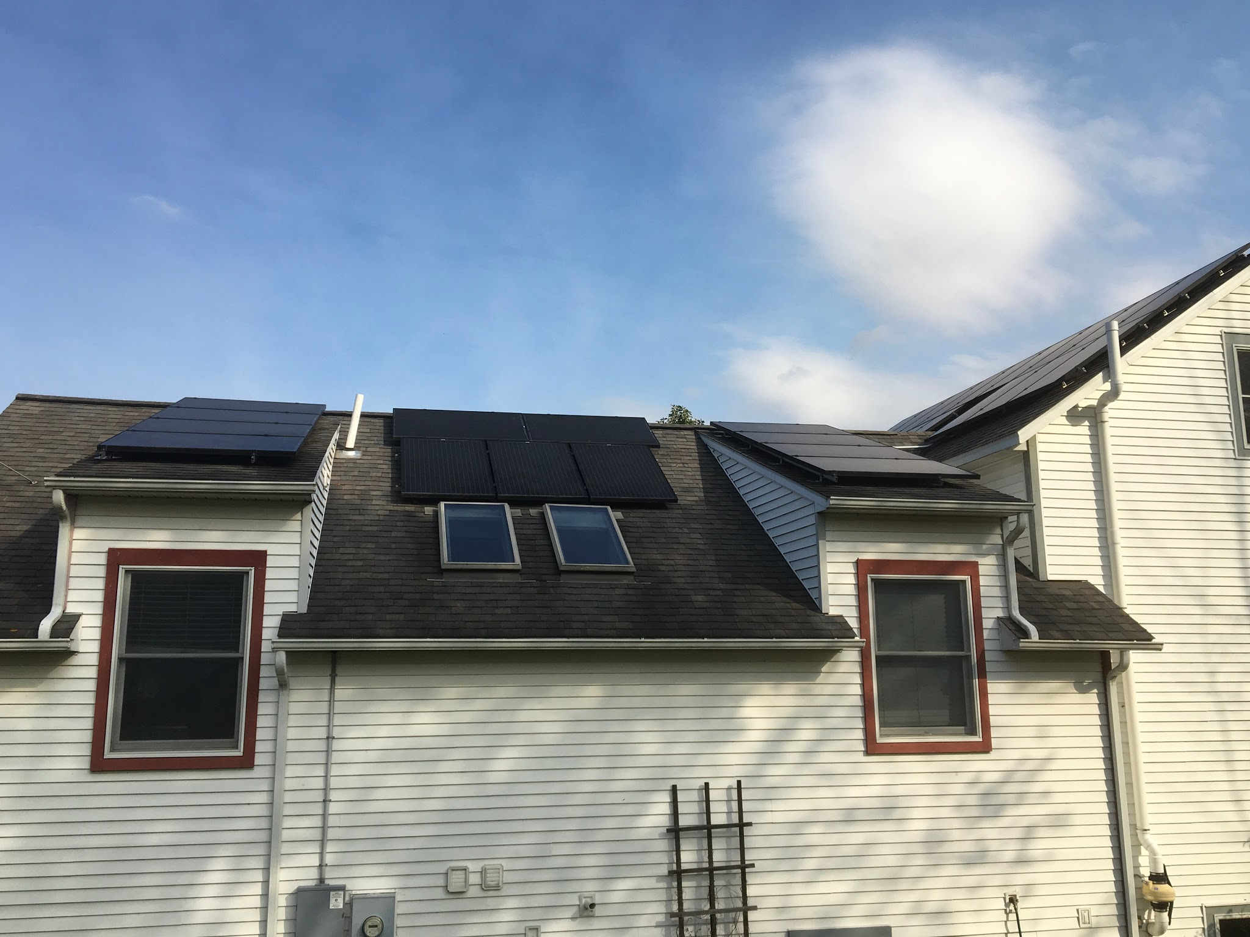
In the Summer, you get the most solar power, unless a swarm of bugs lands on the panels. Also, the days are longer in the Summer, so that allows the solar panels to absorb and transform the sunlight into solar power. In the Winter, you get less solar power, because the days are shorter, and snow could fall on the panels.

Slide 4
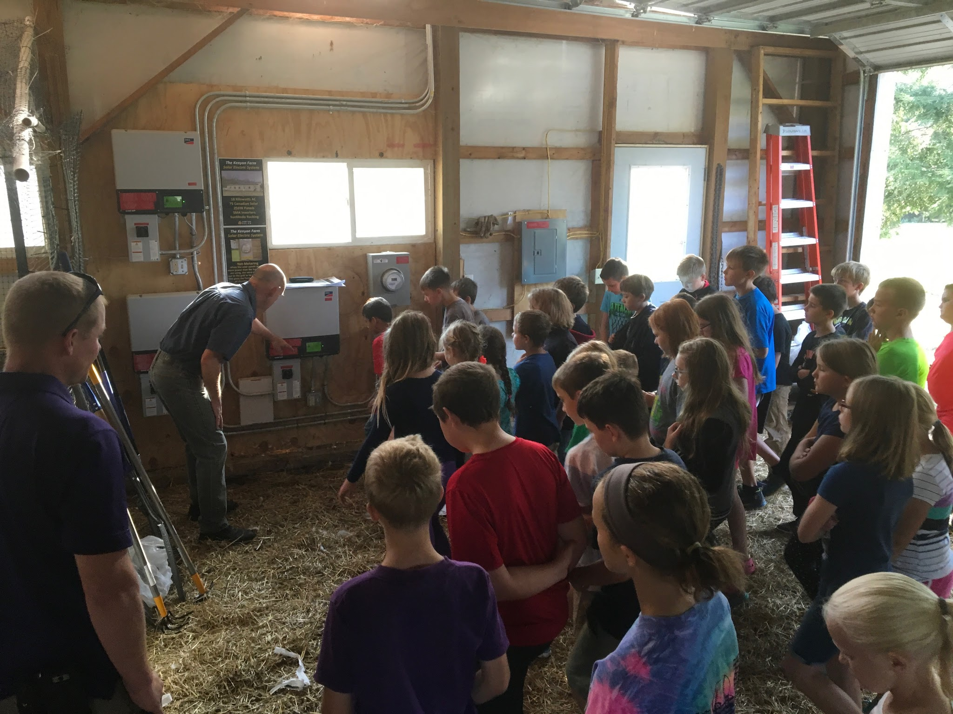
If you don’t use all of your power one day, then it goes to the power lines to be shared with your neighbors, or other people. A single panel can produce about 200 watts of electricity. Each panel is given its own control box, or all of the panels are split into a certain number of groups. If all of the panels share one control box, then your solar power would not be as strong, because if one panel is covered up, then that one panel affects the whole system. Then there would be no other panels with a different control box.

Slide 5
When you use solar power, it helps the environment. By using solar power, you burn less fossil fuels. Also, solar power is renewable, but fossil fuels are not. Burning fossil fuels is not good for the environment. By using solar energy, you can help make the world around you cleaner.

Slide 6
Thank you for watching!
By Saffron Martin

